Slide 1
COVIDIFY

Slide 2
Meet Our Team
ADIT PATEL
SAURABH DUA
UDAIN SRIVASTAVA
MADHAVENDRA SRIVATAVA

Slide 3
Agenda Style
01
TECH STACK USED
Node.js
Bootstrap
CSS
HTML
React
.

Slide 4
PROBLEM STATEMENT
Due to the ongoing pandemic there is a noticeable change in the availability of hospitals .The rapid dissemination of uncorroborated news has led to disruptions in society.
.

Slide 5
SOLUTION
Our application helps to curb the dissemination of uncorroborated news and helps find hospitals near by you. The chatbot on the website helps to navigate through our website.
.

Slide 6
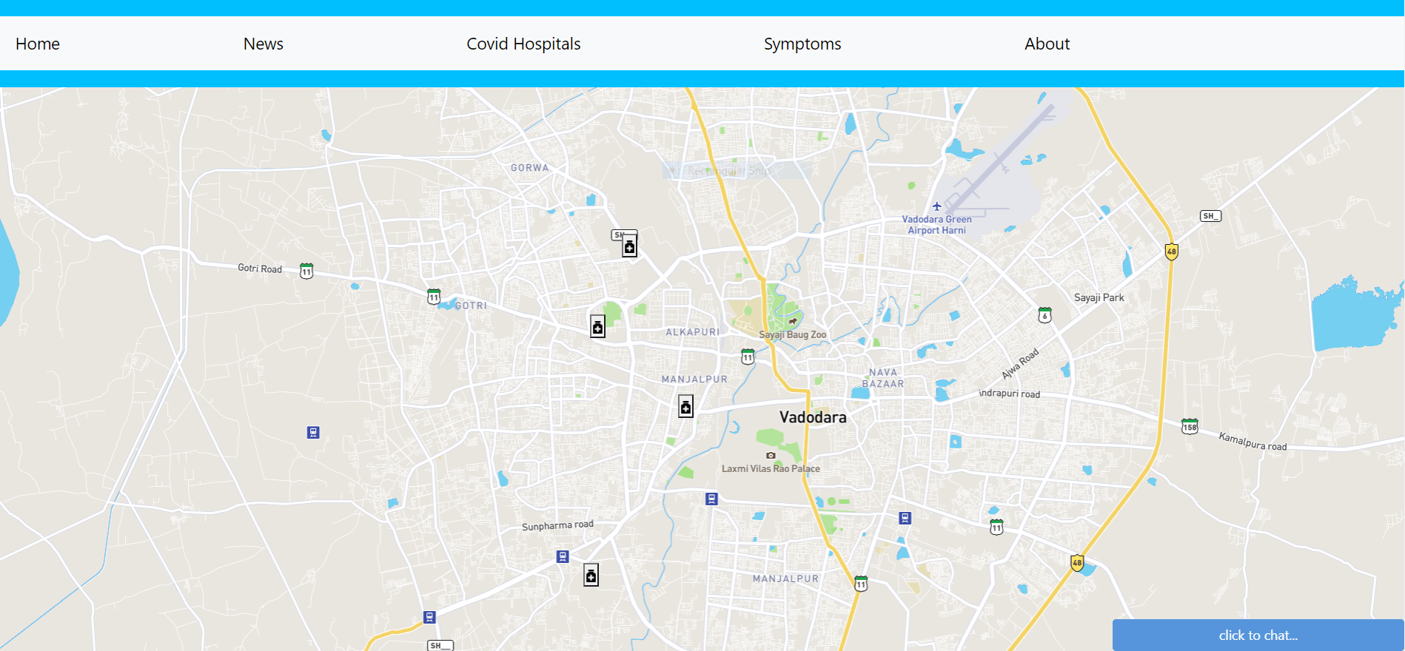
Working Model

Slide 7
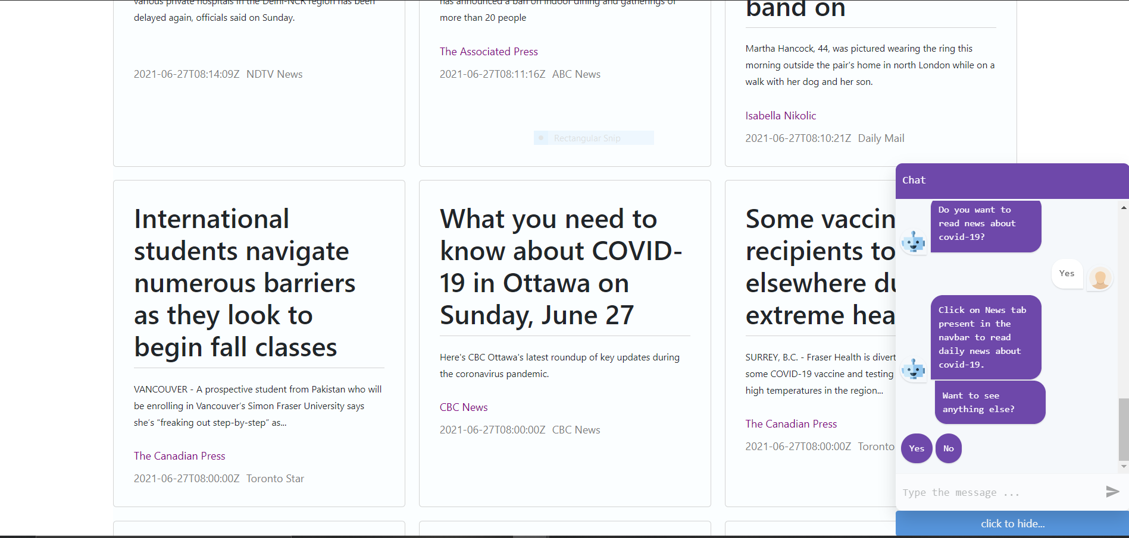
Working Model

Slide 8
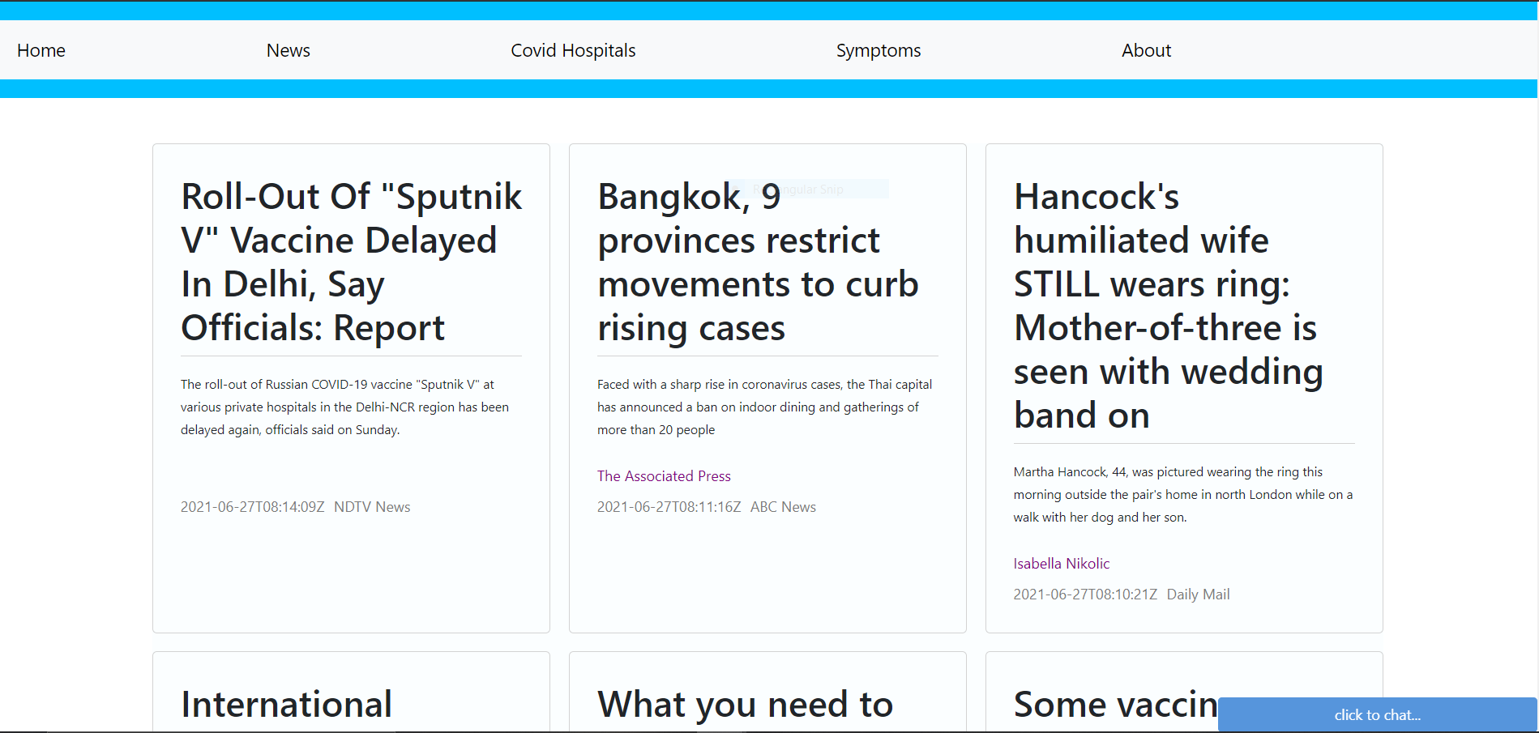
Working Model

Slide 9
THANK YOU

